Slide 1

StoreHopper
Team - Echo.apk

Slide 2
Team Members
App Development -
Ishan Khandelwal
Backend Development –
Hari Prashant Bhimaraju

Slide 3
Inspiration
The need for social distancing and reducing crowds in general has risen at an alarming rate, especially in smaller stores where the risk of Covid-19 or other disease transmissions are high due to their locations in residential areas. Even in a post-COVID-19 scenario, crowd-control at any store is vital to the success of the store. Moreover, there is a lot of time wasted in storing the list of items in your phone's notes or on paper and then reading it out at the store. This also increases physical interaction between the customer and the owner, and thus enhances the risk of transmission.

Slide 4
What is StoreHopper?
An android app to reduce crowd at departmental stores during these different phases of lockdowns by allowing the store owners to update items and peak times regularly, so that the users in that city can get information about the information of nearby stores like crowd strength and item availability.
This project will have the complete system for the mentioned app including user registration, store and store owner registration, item inventory, list requests, etc.

Slide 5
Why StoreHopper?
The store owners can update item availability and peak times on our app.
Additionally, we also aim at making this process of procuring essentials a time-efficient process by letting you send the shopkeepers the list of items you need along with a message.
The shopkeeper can gather and pack the items you need and store it ready to move as you take your time to reach the store, collect it and pay for it.

Slide 6
Features
- Separate registrations for Customer and Store Owners
-Locating registered stores nearby and checking their locations on the map.
- Provision to set item availability and peak times for a store by store owners.
- List requests that customers can send to the store owner to reduce time spent in buying essentials.
- Contacting the shop keepers for additional information is made available through the phone number.

Slide 7
Challenges faced
We planned on having a geospatial database like PostGIS (a PostreSQL extension) on the backend to store geolocations of the stores, but we were unable to successfully integrate it with the backend and deploy, so we switched to a regular database and stored latitude and longitude manually.
The app also faced some issues with Google Maps.
We were unable to link the backend and the frontend completely, the backend is done and deployed, the user interface and the app is ready, but we could only link the API for user registration and authentication, so the app uses its local database for storing everything else at the moment.

Slide 8
How we built it
The server side is developed using Django and the Django-REST-Framework. An API has been created and hosted on Heroku.
The client side is an Android app, coded using Android Studio.
Tech stack used is as follows:
Java Python
Kotlin Django
Android Studio Django-REST-Framework

Slide 9
Accomplishments we are proud of
The plan for the backend implementation was changed about 6 hours into the hack. But the new plan has been implemented successfully and deployed without error.
The app’s UI has been finished successfully. It can also use the local storage for storing the details currently.

Slide 10
What we learned
This is our first project with multiple modules involved like separate structures for customers and storeowners with stores being substructures. We have learnt to successfully create a functioning API with a decent architecture.

Slide 11
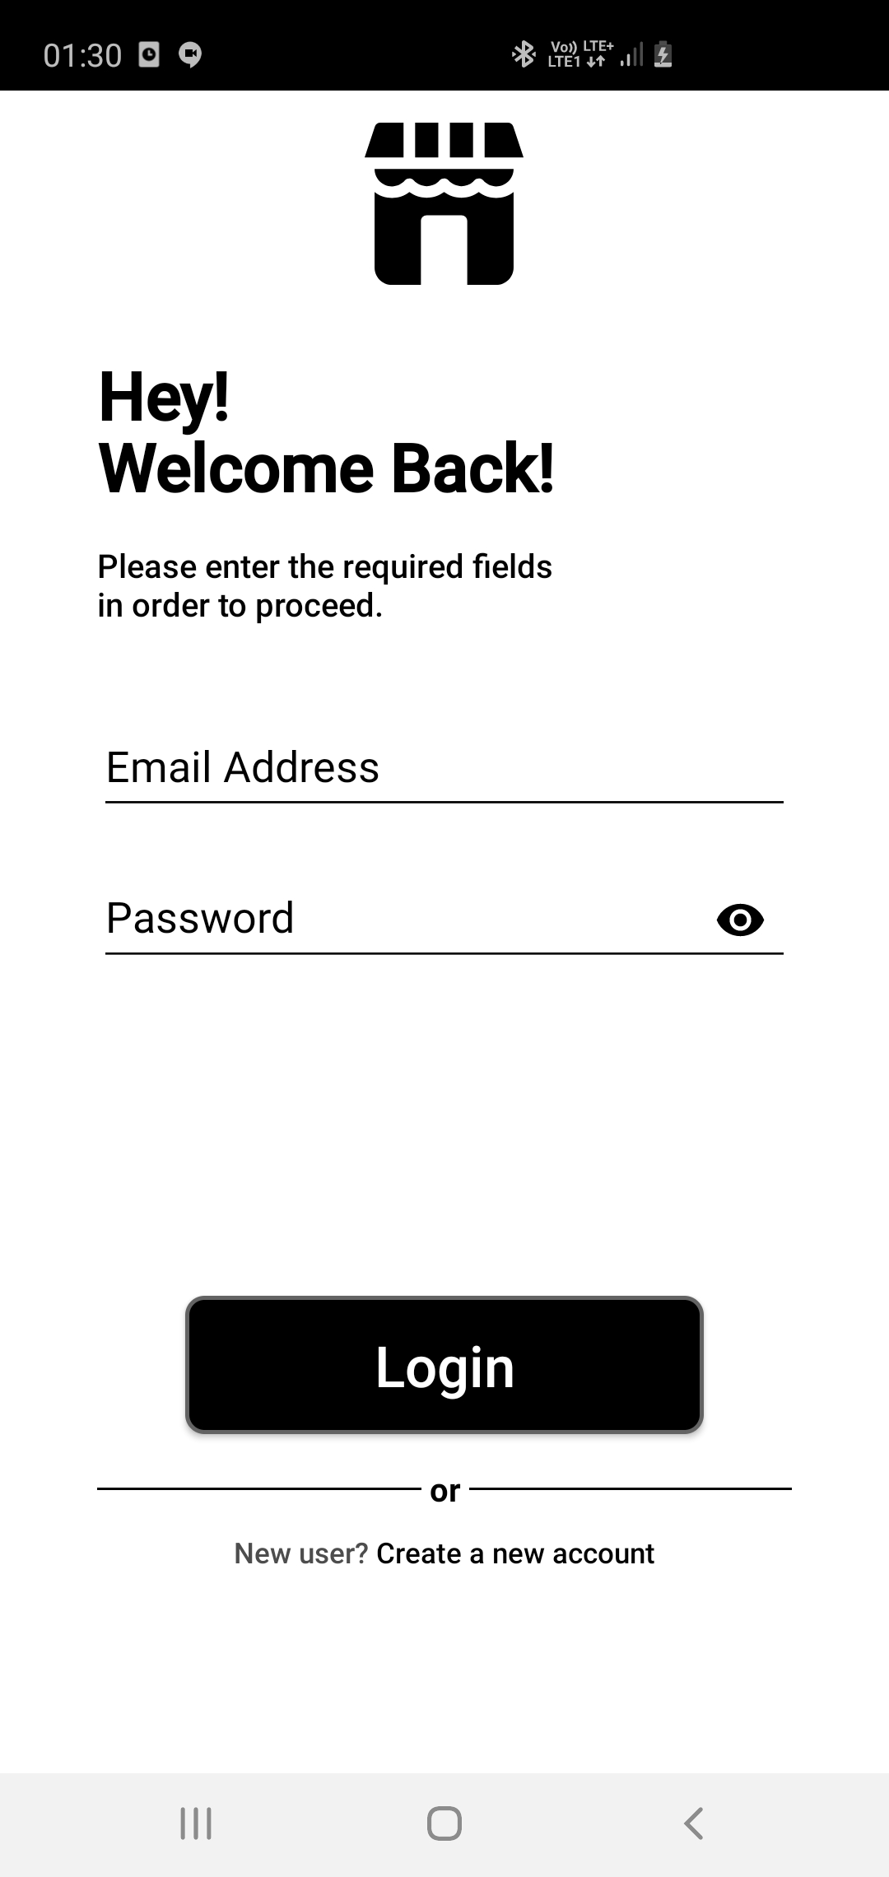
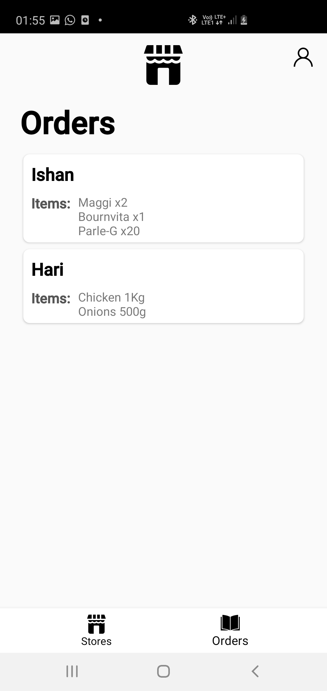
UI

Slide 12
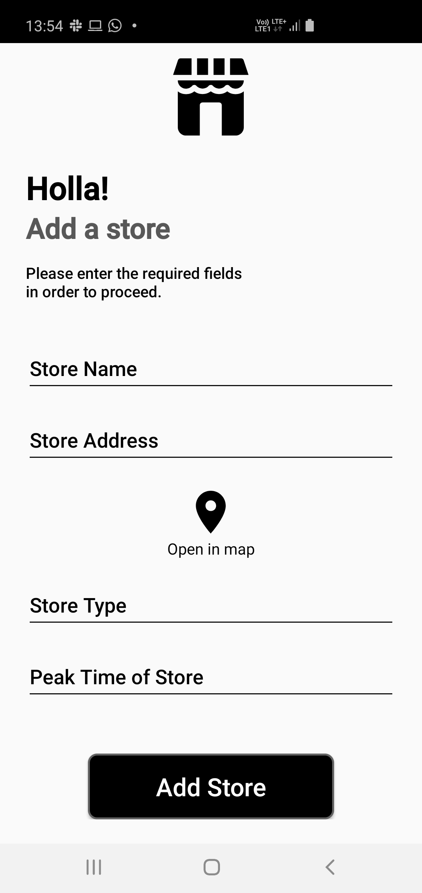
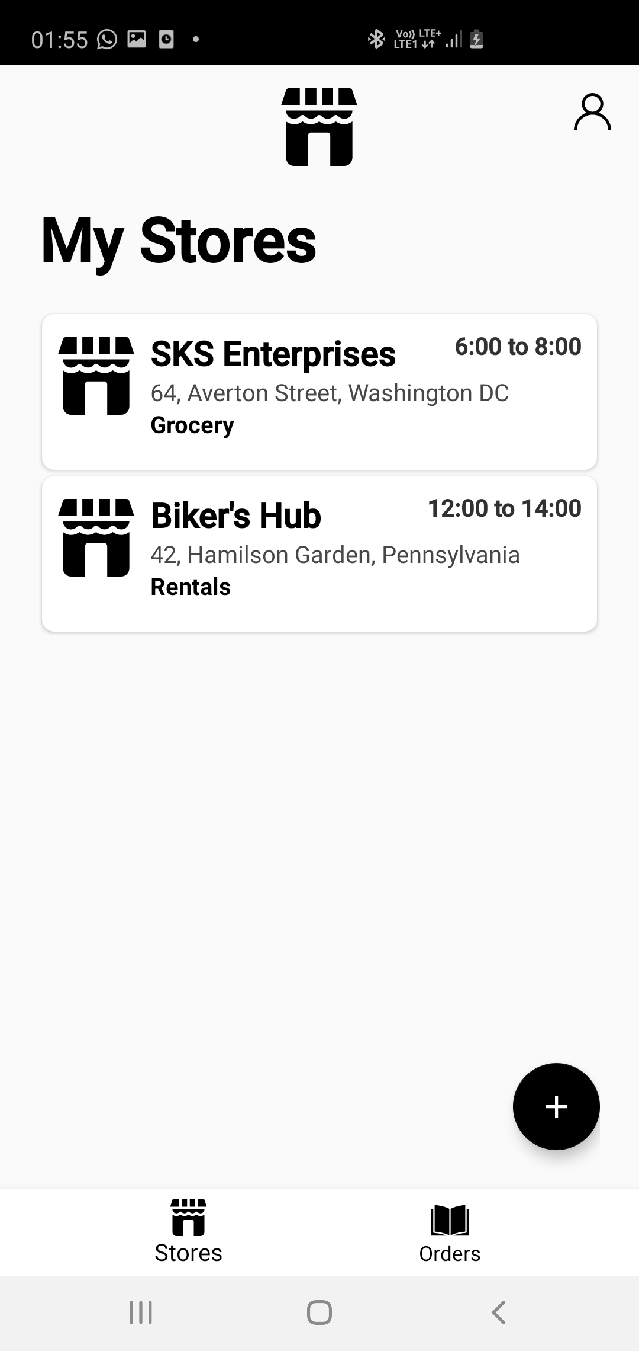

Slide 13
Future Scope
We plan on adding an ML aspect to our project to predict peak times in the stores automatically, reducing the need for manual updates and increasing the reliability of the app.
We also plan on having including a dynamic map updated in real time with stores nearby in any given radius.

